Slide 1


UNIVERSIDAD AUTÓNOMA DEL ESTADO DE HIDALGO
ESCUELA SUPERIOR DE ZIMAPÁN
Licenciatura en Derecho
Tema: So/Neither
L.E.L.I. Maria del Rosario Nolasquez Trejo
Enero – Junio 2014

Slide 2
Tema: So/Neither
Resumen (Abstract)
Reconocer frases y expresiones que denoten acuerdo y/o desacuerdo.
Usar dichas frases y expresiones de manera correcta.
To recognise phrases and expressions that denote agree and disagree.
To use these phrases and expressions in a correct way.
Palabras clave: (keywords)
Agree/disagree
So/Neither

Slide 3
Objetivo general:
El alumno podrá expresar y fundamentar acuerdos y desacuerdos, realizar invitaciones así como aceptar o rechazar las realizadas por terceros. Asimismo, podrá expresar preferencias, obligaciones y necesidades.

Slide 4
Nombre de la unidad: Expresar acuerdos, desacuerdos y sentimientos personales.
Objetivo de la unidad: Expresar opiniones sobre temas diversos, enfatizando si se está de acuerdo o no y que sentimientos provoca tal situación.

Slide 5
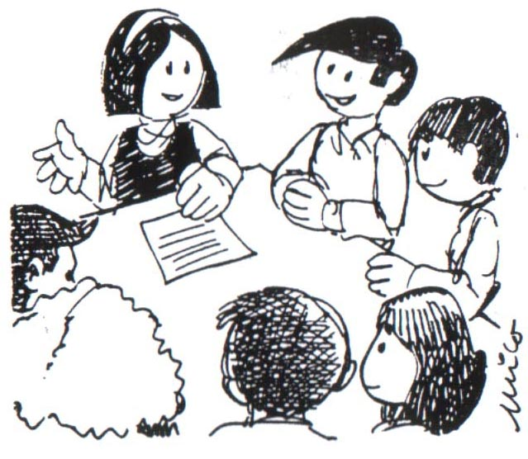
Tema: So/Neither
1.1. Expresar acuerdos y desacuerdos.
Introducción:
We use So + auxiliary + I to agree with positive sentences.
So do I
I really love travelling.
I enjoyed the concert.
I am excited about the party
So did I
So am I

Slide 6

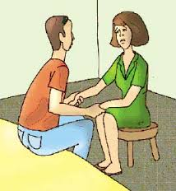

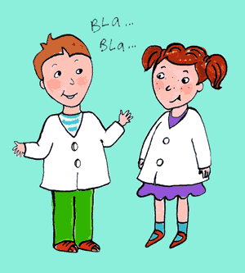
Desarrollo del tema:
We use Neither + auxiliary + I to agree with negative sentences.
Neither do I.
I don’t go out much.
Neither did I.
I didn’t sleep well.
I can’t play basketball.
Neither can I.

Slide 7

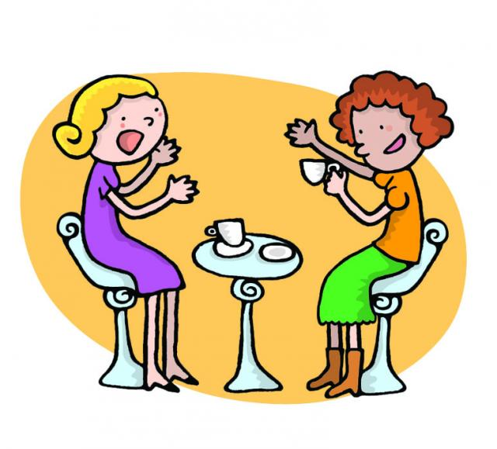
We use a positive form of an auxiliary to disagree with a negative sentence.
I don’t like cycling.
Oh, I do.
Oh, I will.
I won’t go to work on Saturday.

Slide 8
We use a negative form of an auxiliary to disagree with a positive sentence.
I’m student.
Oh, I’m not.
I’ve studied English.
Oh, I haven’t
I like pizza.
Oh, I don’t
I excercised this morning
Oh, I didn’t

Slide 9
Auxiliary verbs.
are/is/am
do/does
have/has
did
will
should
would
might
can
could
may
must
ought
was/were

Slide 10
Conclusión o cierre:
We use so/neither to agree with positive sentences and so/neither to agree with negative sentences.
Finding things in common
 | agree | disagree
1 I am vegetarian 2 I have a dog 3 I didn’t watch the TV yesterday 4 I can’t swim 5 I wish it was Saturday 6 I shouldn’t clean my room. 7 I must wear a tie to school. | So am I So have I Neither did I Neither can I So do I Neither should I So must I | Oh, I’m not Oh, I haven’t Oh, I did Oh, I can Oh, I don’t Oh, I shouldn’t Oh, I musn’t

Slide 11
Bibliografía del tema:
(Establecer referencias bibliográficas. ( mínimo 3)
Redston, C. y Cunningham, G. (2005). Face2face Pre-intermediate Student’s Book. Italy: Cambridge.
LearnEnglish.
Ompersonal. (1999). Recuperado el 24 de marzo de 2014, de ompersonal:http://www.ompersonal.com.ar/omverbs/regularverbs.htm
Murphy, Raymond. (2001). English Grammar In use. Great Britain:Cambridge University Press.

